Slide 1
CHAPTER- 1
Managing and the Manager’s Job

Slide 2
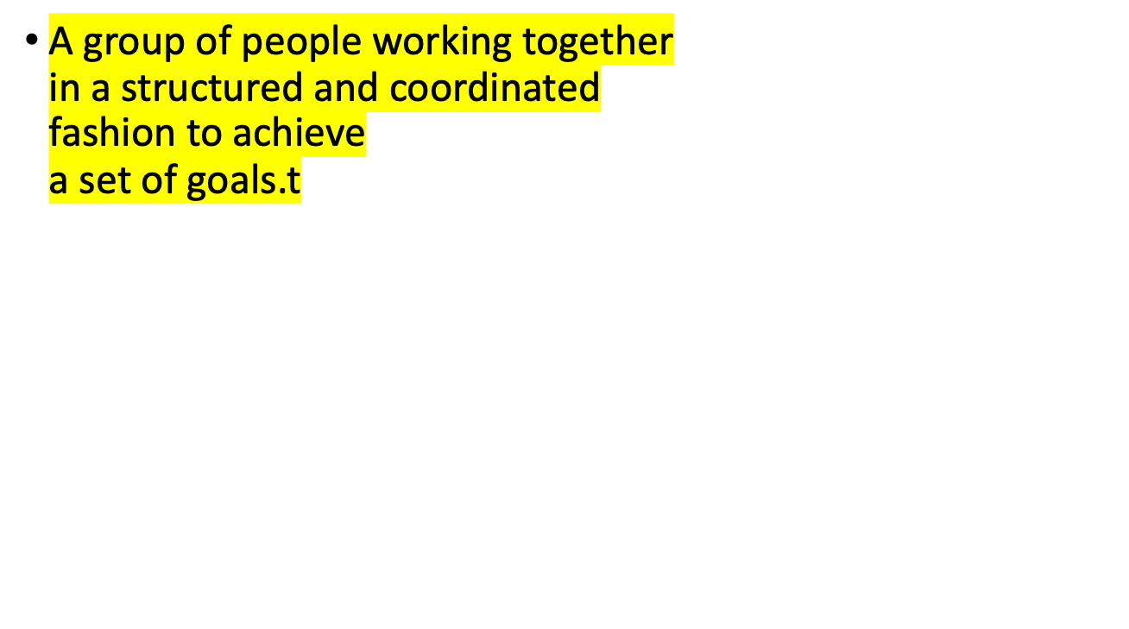
What is an organization?
1–<number>

Slide 3


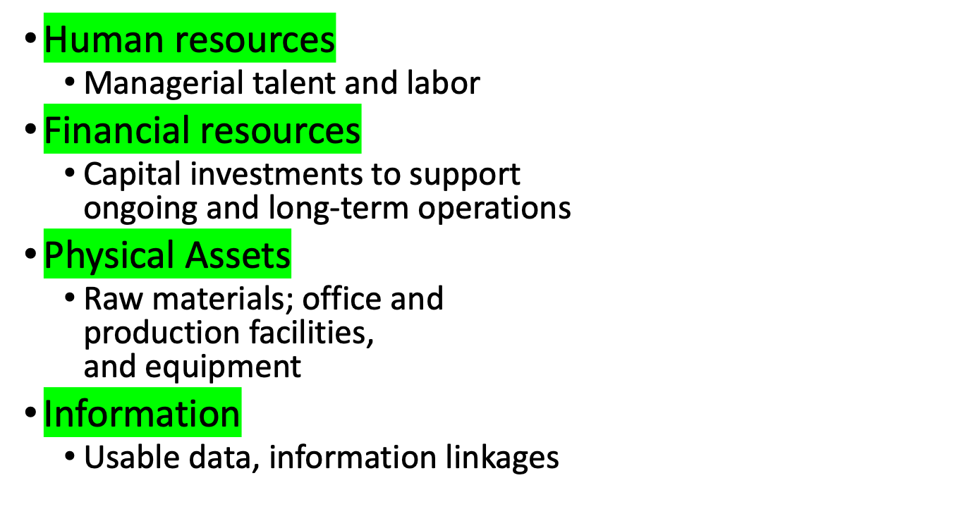
1–<number>
Notes:
4

Slide 4

What is Management?
A set of activities
  planning and decision making, organizing, leading, and controlling
directed at an organization’s resources
  human, financial, physical, and information
with the aim of achieving organizational goals in
an efficient and effective
manner.
1–<number>
Notes:
5

Slide 5

Planning and
Decision Making
Organizing
Setting the organiza-
Determining how
tion
’
s goals and
best to group
deciding how best
activities and
to achieve them
resources
Controlling
Leading
Monitoring
Motivating members
and correcting
of the organization
ongoing activities
to work in the best
to facilitate goal
interests of the
attainment
organization
Figure 1.2
1–<number>

Slide 6

Planning and Decision Making
  Setting an organization’s goals and selecting a course of action from a set of alternatives to achieve them.
Organizing
  Determining how activities and resources are to be grouped.
Leading
  The set of processes used to get members of the organization to work together to advance the interests of the organization.
Controlling
  Monitoring the organization’s progress towards its goals.
1–<number>
Notes:
9

Slide 7
Basic Purpose of Management
EFFICIENTLY
Using resources wisely and
in a cost-effective way
And
EFFECTIVELY
Making the right decisions and
successfully implementing them
1–<number>
Notes:
6

Slide 8

Planning
and decision
Organizing
making
Inputs from the environment
•
Human resources
Goals attained
•
Financial resources
•
Efficiently
•
Physical resources
•
Effectively
•
Information resources
Controlling
Leading
Figure 1.1
1–<number>

Slide 9

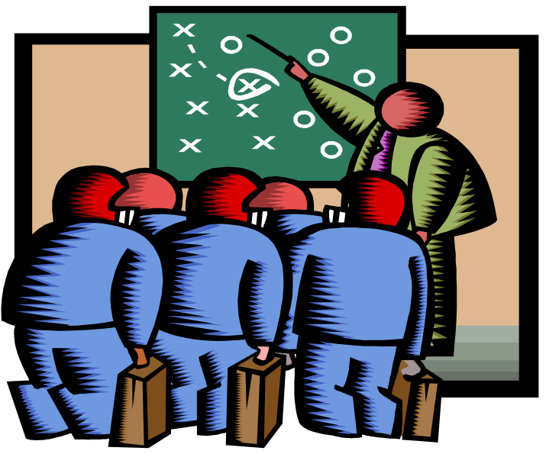
Someone whose primary responsibility is to carry out the management process.
Someone who plans and makes decisions, organizes, leads, and controls human, financial, physical, and information resources.
1–<number>

Slide 10
Kinds of Managers by Level and Area
Levels of Management
Top managers
Middle managers
First-line managers
Marketing
Finance
Operations
Other
Human resources
Administration
Areas of Management
Figure 1.3
1–<number>

Slide 11

Top Managers
  The relatively small group of executives who manage the overall organization. They create the organization’s goals, overall strategy, and operating policies.
Middle Managers
  Largest group of managers in organizations who are primarily responsible for implementing the policies and plans of top managers. They also supervise and coordinate the activities of lower level managers.
First-Line Managers
  Managers who supervise and coordinate the activities of operating employees.
1–<number>

Slide 12

Marketing Managers
  Work in areas related to getting consumers and clients to buy the organization’s products or services—new product development, promotion, and distribution.
Financial Managers
  Deal primarily with an organization’s financial resources—accounting, cash management, and investments.
Operations Managers
  Concerned with creating and managing the systems that create organization’s products and services—production control, inventory, quality control, plant layout, site selection.
1–<number>

Slide 13

Human Resource Managers
  Involved in human resource planning, recruiting and selecting employees, training and development, designing compensation and benefit systems, formulating performance appraisal systems, and discharging low-performing employees.
Administrative Managers
  Generalists who are familiar with all functional areas of management and who are not associated with any particular management specialty.
Other Kinds of Managers
  Organizations have developed specialized managerial positions (e.g., public relations managers) directly related to the needs of the organization.
1–<number>

Slide 14

Interpersonal Roles
  Figurehead, leader, and liaison roles involve dealing with other people.
Informational Roles
  Monitor, disseminator, and spokesperson roles involve the processing of information.
Decisional Roles
  Entrepreneur, disturbance handler, resource allocator, and negotiator are managerial roles primarily related to making decisions.
1–<number>
Notes:
12

Slide 15

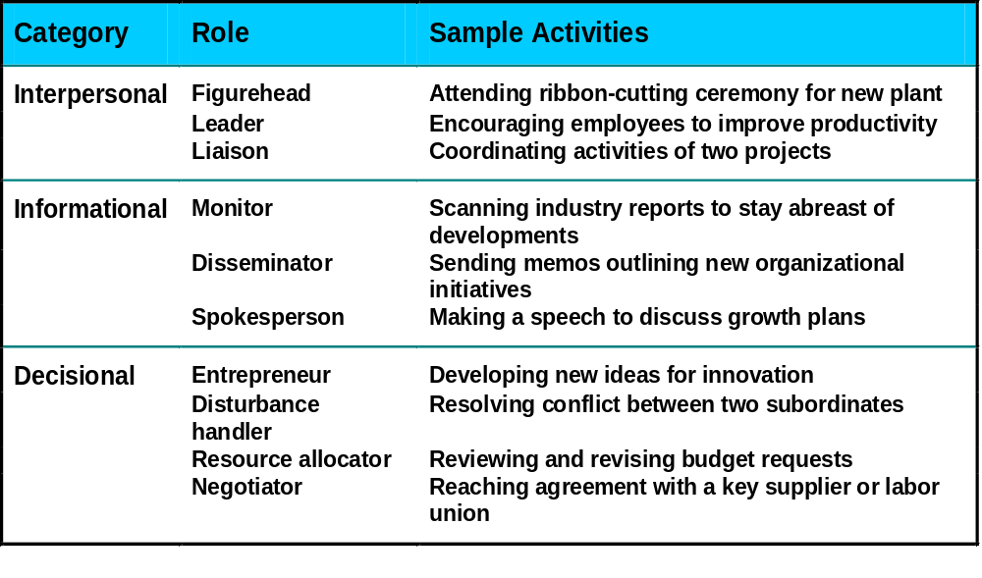
Table 1.2
1–<number>

Slide 16

Technical
  Skills necessary to accomplish or understand the specific kind of work being done in an organization.
Interpersonal
  The ability to communicate with, understand, and motivate both individuals and groups.
Conceptual
  The manager’s ability to think in the abstract.
Diagnostic
  The manager’s ability to visualize the most appropriate response to a situation.
1–<number>
Notes:
17

Slide 17

Communication
  The manager’s abilities both to convey ideas and information effectively to others and to receive ideas and information effectively from others.
Decision-Making
  The manager’s ability to recognize and define problems and opportunities correctly and then to select an appropriate course of action to solve the problems and capitalize on opportunities.
Time-Management
  The manager’s ability to prioritize work, to work efficiently, and to delegate appropriately.
1–<number>
Notes:
17

Slide 18

Science of Management
  Assumes that problems can be approached using rational, logical, objective, and systematic ways.
  Requires the use of technical, diagnostic, and decision-making skills and techniques to solve problems.
Art of Management
  Decisions are made and problems solved using a blend of intuition, experience, instinct, and personal insights.
  Requires the use of conceptual, communication, interpersonal, and time-management skills to successfully accomplish the tasks associated with managerial activities.
1–<number>
Notes:
18

Slide 19

Sources of Management Skills
Sound educational
base; continued
life-long educational
experiences
Successful
acquisition and
utilization of basic
management skills
Initial job experiences;
continued experiences
through a variety of
job assignments
Figure 1.4
1–<number>

Slide 20

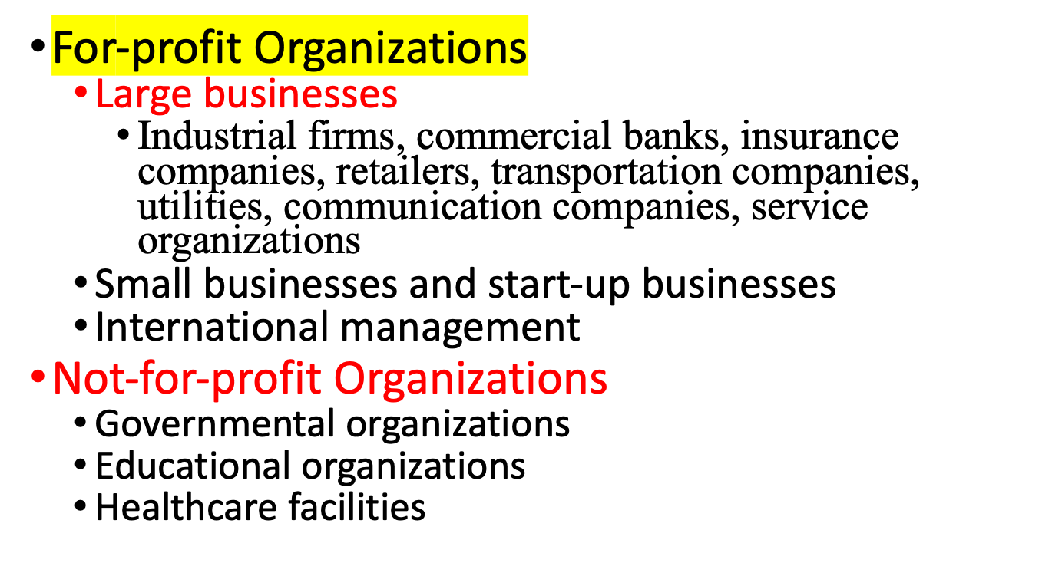
1–<number>
Notes:
21

